Slide 1
Name :ARYAN J GILDER ENROLLMENT NO : 21162101006
PROJECT : STOPWATCH

Slide 2
In this program, we will use a function called _kbhit().
_kbhit():
It is a function used to determine if a key has been pressed or not. You have to include conio.h to work with this function. It generally checks if key is pressed or not. If a key is pressed it returns non zero value otherwise zero.
SLEEP() :
This function is used to hold the program execution for a given number of milliseconds. it is declared in “Windows.h” header file.
We increment the SS (seconds) variable after the program waits for 1 second and when the seconds variable hits 60, we change it zero and increment the MM (minute) variable. When the minute hits 60 we change it to zero and increment HH (hour) variable.

Slide 3
getch():
The getch() function basically stands for 'get character'. As one would understand from the title, getch() gets a character from the user.
While loop :
The syntax of a while loop in C++ is − while(condition) { statement(s); } Here, statement(s) may be a single statement or a block of statements.

Slide 4
#include<iostream>
#include<conio.h>
#include<Windows.h>
using namespace std;
int main()
{
system("cls");
int HH=0,MM=0,SS=0;
cout<<"\n\t\t stopwatch";
cout<<"\n\t\t HH: MM: SS";
cout<<"\n\t\t "<<HH<<" : "<<MM<<" : "<<SS;
cout<<"\n\t\t press any key to start";
_getch();
while(!_kbhit())
{

Slide 5
SS++;
Sleep(1000);
if(SS>59)
{
MM++;
SS=0;
}
if(MM>59)
{
HH++;
MM=0;
}
system("cls");
cout<<"\n\t\t stopwatch";
cout<<"\n\t\t HH: MM: SS";
cout<<"\n\t\t "<<HH<<" : "<<MM<<" : "<<SS;
cout<<"\n\t\t press any key to stop";
}

Slide 6
_getch();
cout<<"\n\t\t the time after pausing is";
cout<<"\n\t\t "<<HH<<" : "<<MM<<" : "<<SS;
_getch();
return 0;
}

Slide 7
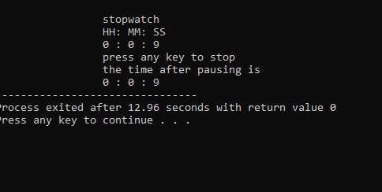
OUTPUT :

Slide 8
THANKYOU

